Slide 1
CAMEO Names
JRC-NAMES: A Freely Available, Highly Multilingual
Named Entity Resource

Slide 2
CAMEO Data Set
Phoenix.agents.txt
Lines Processed for Cameo.Phoenix.agents is : 2292
Records created for Cameo.Phoenix.agents is : 1972
Phoenix.Countries.actors.txt
Lines Processed for Cameo.Phoenix.Countries.actors is : 54410
Records created for Cameo.Phoenix.Countries.actors is : 286
Phoenix.International.actors.txt
Lines Processed for Cameo.Phoenix.International.actors is : 7976
Records created for Cameo.Phoenix.International.actors is : 7526
Phoenix.MilNonState.actors.txt
Lines Processed for Cameo.Phoenix.MilNonState.actors is : 2680
Records created for Cameo.Phoenix.MilNonState.actors is : 959

Slide 3

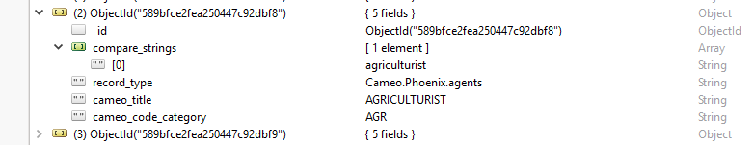
Phoenix.agents

Slide 4
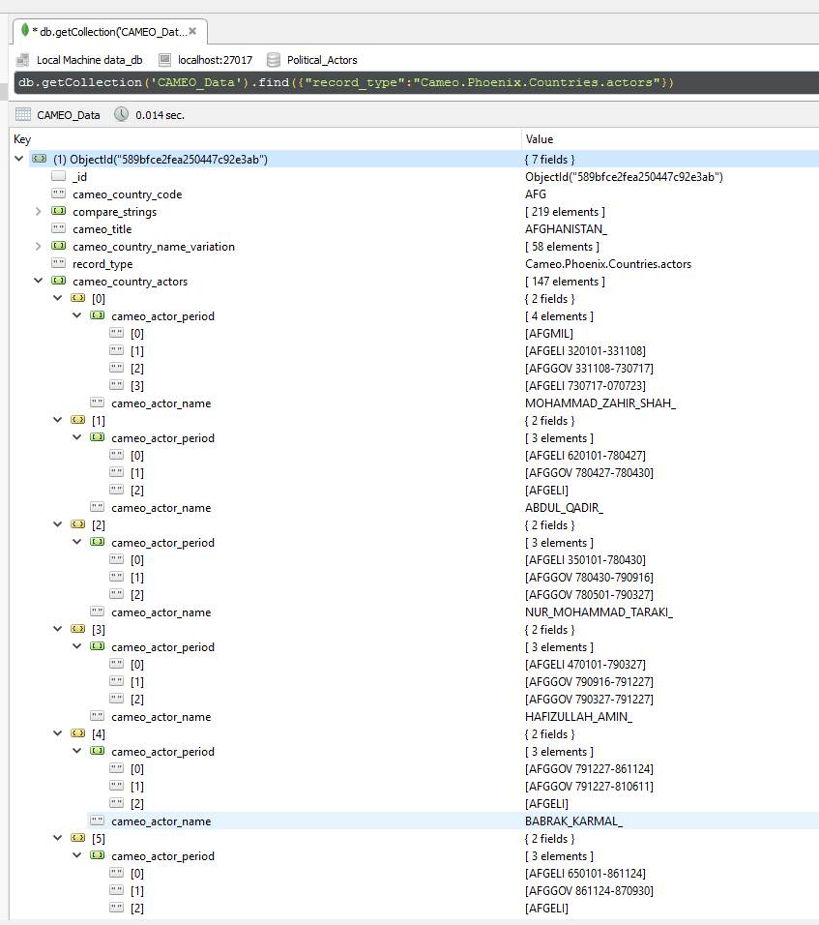
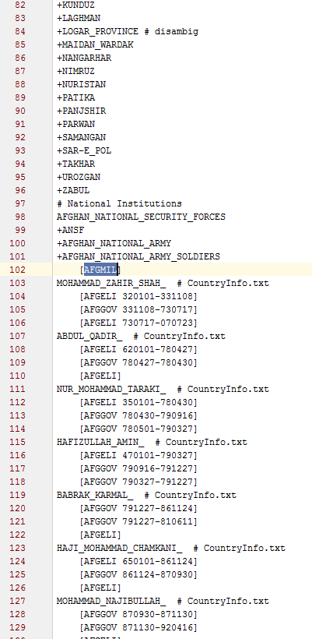
Phoenix.Countries.actors

Slide 5
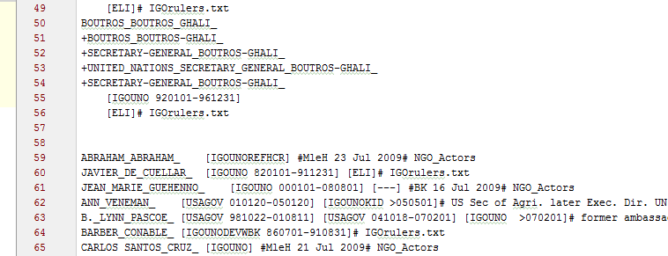
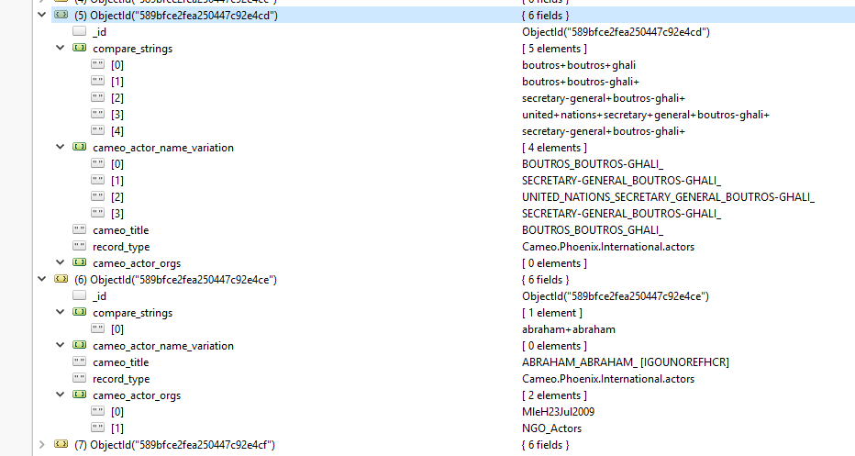
Phoenix.International.actors & Phoenix.MilNonState.actors

Slide 6
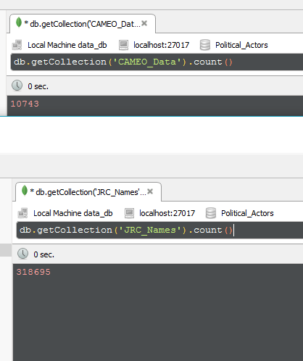
3,423,740,385,000 approx.. String comparisons needed for finding relation

Slide 7
CAMEO_JRC_Relation
{
"_id" : <Record ID>
"jrc_id" : <Record ID in JRC_Names table>
"jrc_code" : <JRC ID for the entity>,
"cameo_title" : “<CAMEO Title / country name for connected record>",
"cameo_id" : <Record ID in CAMEO_Data table>
"compare_string" : <String compared that can be hashed or indexed for serch> Eg: "chamber+of+commerce"
}

Slide 8
Stats
Total Records found by many-to-many string comparison : 7427
Approx. ~7000 unique entities (Person/Organisation)
Most relation found in Phoenix.Countries.actors – 6423 connections
Time to generate the data after running 4 instances targeting 4 different CAMEO files separately all running in parallel: 11 hours
Time to generate data only from Phoenix.Countries.actors : 55 minutes
Better Improvement possible with Apache Spark.
Data: https://github.com/SubhasisDutta/CAMEO-JRC-Database/blob/master/data/cameo_jrc/cameo_CountryActors_with_jrc.txt

Slide 9
Reference
CAMEO Data: https://github.com/openeventdata/UniversalPetrarch/tree/master/UniversalPetrarch/data/dictionaries
Code Repo : https://github.com/SubhasisDutta/JRC-Name-Parser

